Slide 1

Enhancing Collections Strategy
Proactive Delinquency Management for Improved Financial Outcomes
Project By - Dhritimalya Dutta dhritimalyadutta@gmail.com

Slide 2

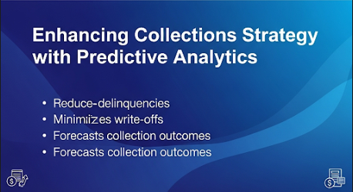
Introduction
This presentation will explore the key risk factors contributing to customer delinquency and emphasize the importance of implementing predictive analytics in our collections strategy to enhance financial outcomes.

Slide 3

01
Risk Factors

Slide 4
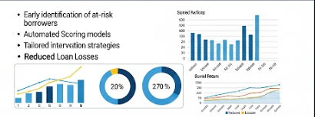
Deteriorating Payment History
Customers who show a pattern of late or missed payments are at a significantly higher risk of falling into delinquency. Analyzing payment trends provides insights into a customer's reliability and identifies those who may soon struggle to meet their financial obligations.

Slide 5
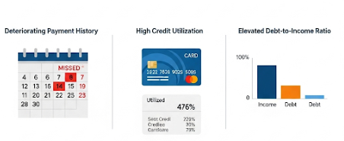
High Credit Utilization
A high level of credit utilization indicates that customers are using a large portion of their available credit, often signaling financial distress. Monitoring credit utilization rates allows us to identify at-risk individuals and intervene before they default.

Slide 6

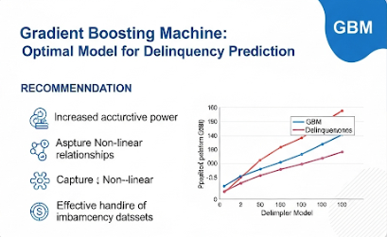
Elevated Debt-to-Income Ratio
A high debt-to-income ratio indicates that a customer's debt burden is disproportionate to their income, suggesting potential challenges in meeting financial obligations. This metric is crucial for identifying clients who may need assistance before they reach a delinquent status.

Slide 7

02
Predictive Modeling

Slide 8
Gradient Boosting Machine Recommendation
We recommend implementing a Gradient Boosting Machine model to enhance our delinquency management strategy. This data-driven approach allows for the identification of high-risk customers with superior accuracy, facilitating proactive interventions and minimizing losses.

Slide 9
Implementation Timeline
The proposed timeline for the Gradient Boosting Machine deployment includes developing and validating the model from Q1 to Q2 2024, followed by integration into existing systems in Q3 2025. Training for the collections team will also occur during this period to ensure effective usage of the new model.

Slide 10

Expected Outcomes
The implementation of the Gradient Boosting Machine model is expected to achieve a 10% reduction in the total value of new delinquent accounts within six months of deployment. This proactive strategy will enhance resource allocation, leading to better financial outcomes for the organization.

Slide 11
Conclusions
In summary, adopting predictive analytics through the Gradient Boosting Machine model will transform our collections strategy. By identifying risk factors early and implementing targeted interventions, we can significantly reduce delinquency rates and enhance overall financial stability.

Slide 12
Thank you!
Do you have any questions?

